Slide 1
Automatic Error Detection (Rule-based)
Tanvi Kamble and E Nikhil

Slide 2
The Problem:
For a test data the pos tagger assigns the following tags.
सिंह CC_CCS → wrong
ने PSP
रीगन QT_QTC → wrong
को PR_PRP → wrong
विश्व N_NN
हस्ती N_NN
और CC_CCD
भारत RD_SYM → wrong
का CC_CCD → wrong
मित्र N_NN
बताया V_VM
। PSP → wrong
AIM: Detect if the pos tag assigned per word is correct or not

Slide 3
Rule based Detector

Slide 4
Steps taken:
Search for features of training data
Compare accuracy
Extract Features
Create dictionary

Slide 5
Step 1:
For sentence
इसे PR_PRP
नवाब N_NN
शाहजेहन N_NNP
ने PSP
बनवाया V_VM
था V_VAUX
। RD_PUNC
The features for शाहजेहन will be:
शाहजेहन N_NNP
1 शाहजेहन नवाब
2 शाहजेहन नवाब इसे
3 शाहजेहन इसे
4 शाहजेहन नवाब ने
5 शाहजेहन ने बनवाया
6 शाहजेहन ने
7 शाहजेहन बनवाया
8 ेहन N_NNP (the suffix)

Slide 6
विराजमान JJ:
विराजमान भी
विराजमान भी प्रतिमाएँ
विराजमान प्रतिमाएँ
विराजमान भी हैं
विराजमान हैं ।
विराजमान हैं
विराजमान ।
विराजमान पर
विराजमान पर पद
विराजमान पद
विराजमान पर होंगे
विराजमान होंगे ।
विराजमान होंगे
विराजमान ।
Suppose for a word:
देश N_NN
1 देश पूरे f₁ = 1
2 देश पूरे इज्तिमा f₂ = 0
3 देश इज्तिमा f₃ = 1
4 देश पूरे के f₄ = 1
5 देश के लोगों f₅ = 0
6 देश के f₆ = 1
7 देश लोगों f₇ = 0
8 देश N_NN f₈ = 1
Where f_{i} represents 1 if the feature is present.
S = ∑f_{i}
If S > 1/2/3/→ The POS tag assigned is correct (output 0)
Step 2:
Step 3:
All the features belonging to a set of word and pos tag are placed together
Determine if each word is present in the BIS wordlist (in which case the if the pos tag is same then it is correct else not) search for features in the dictionary and assign values to f_{i}. Check for the suffix from the suffix dictionary.

Slide 7
Step 4: Calculating Accuracy
Important Assumptions:
If a word, tag pair is not found in the dictionary, we assume the correct tag to be NN and check accordingly.
If a word which belongs to one of the BIS wordlists but the POS tag is not the corresponding one, we directly declare that the assigned POS tag is wrong, we do not check for the word in the features dictionary as we assume that there are no exception to closed class words.
The closed class words have no entries in the dictionary as they are constant with almost no exception
For this, we check the obtained binary values with the Gold Binary values
सिंह CC_CCS 1 1
ने PSP 0 0
रीगन QT_QTC 1 1
को PR_PRP 1 1
विश्व N_NN 0 0
हस्ती N_NN 0 0
और CC_CCD 0 1
भारत RD_SYM 1 0
का CC_CCD 1 1
मित्र N_NN 0 1
बताया V_VM 0 0
। PSP 1 1
(Gold)(Actual)
Now comparing these two we get the Accuracy of the system!

Slide 8
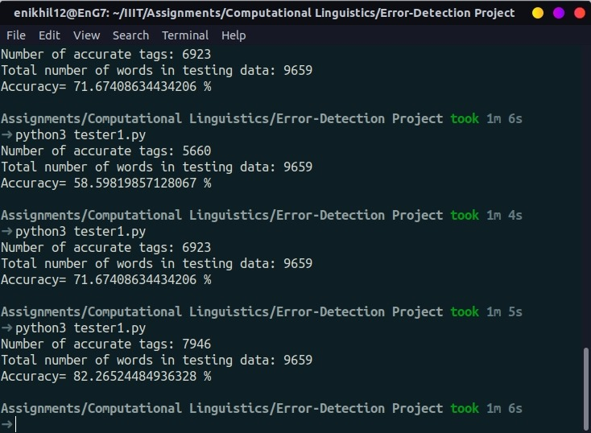
RESULT
The image on the right shows the respective results for the pos tag to be corrext the sum of the features in the test data are taken to be 3, 2 and 1

Slide 9
Thank You

